Slide 1

University of Information Technology and Sciences
Digital Logic Design
Course No. : CSE 253
Lecture no. : 01
Conducted By :
Md.Yousuf Ali
Lecturer
Department of CSE, UITS
yousuf.ali@uits.edu.bd

Slide 2
Analog and Digital System, concept of number systems, non-positional and positional number, systems, decimal, binary, hexadecimal and octal system, Conversion,
Number Systems

Slide 3
Analog and Digital Signal
Analog system
The physical quantities or signals may vary continuously over a specified range.
Digital system
The physical quantities or signals can assume only discrete values.
Greater accuracy
X(t)
X(t)
Analog signal
Digital signal
t
t

Slide 4
Number System
A number system defines how a number can be represented using distinct symbols. A number can be represented differently in different systems. For example, the two numbers (2A)₁₆ and (52)₈ both refer to the same quantity, (42)₁₀, but their representations are different.
Several number systems have been used in the past and can be categorized into two groups: positional and non-positional systems. Our main goal is to discuss the positional number systems, but we also give examples of non-positional systems.

Slide 5
The decimal system (base 10)
The word decimal is derived from the Latin root decem (ten). In this system the base b = 10 and we use ten symbols
S = {0, 1, 2, 3, 4, 5, 6, 7, 8, 9}
The symbols in this system are often referred to as decimal digits or just digits.

Slide 6
Decimal Number System
Base (also called radix) = 10
10 digits { 0, 1, 2, 3, 4, 5, 6, 7, 8, 9 }
Digit Position
Integer & fraction
Digit Weight
Weight = (Base) ^{Position}
Magnitude
Sum of “Digit x Weight”
Formal Notation
2
1
0
-1
-2
5
1
2
7
4
100
10
1
0.1
0.01
500
10
2
0.7
0.04
d₂*B²+d₁*B¹+d₀*B⁰+d₋₁*B⁻¹+d₋₂*B⁻²
(512.74)₁₀

Slide 7
Example : Decimal Number system
The following shows the place values for the decimal number −7508. We have used 1, 10, 100, and 1000 instead of powers of 10.
(
)
Values
Note that the digit 2 in position 1 has the value 20, but the same digit in position 2 has the value 200. Also note that we normally drop the plus sign, but it is implicit.

Slide 8
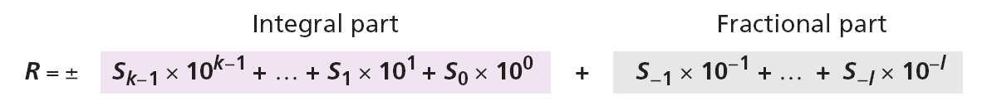
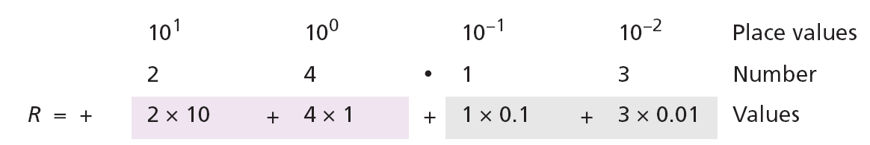
Real Number
Example
The following shows the place values for the real number +24.13.

Slide 9
The binary system (base 2)
The word binary is derived from the Latin root bini (or two by two). In this system the base b = 2 and we use only two symbols,
S = {0, 1}
The symbols in this system are often referred to as binary digits or bits (binary digit).

Slide 10
Binary Number System
Base = 2
2 digits { 0, 1 }, called binary digits or “bits”
Weights
Weight = (Base) ^{Position}
Magnitude
Sum of “Bit x Weight”
Formal Notation
Groups of bits
4 bits = Nibble
8 bits = Byte
4
2
1
1/2
1/4
1
0
1
0
1
2
1
0
-1
-2
1 *2²+0 *2¹+1 *2⁰+0 *2⁻¹+1 *2⁻²
=(5.25)₁₀
(101.01)₂
1 0 1 1
1 1 0 0 0 1 0 1

Slide 11
Example: Binary Number system
The following shows that the number (11001)₂ in binary is the same as 25 in decimal. The subscript 2 shows that the base is 2.
The equivalent decimal number is N = 16 + 8 + 0 + 0 + 1 = 25.

Slide 12
Real Binary number
Example: Real Binary Number
The following shows that the number (101.11)₂ in binary is equal to the number 5.75 in decimal.

Slide 13
The octal system (base 8)
The word octal is derived from the Latin root octo (eight). In this system the base b = 8 and we use eight symbols to represent a number. The set of symbols is
S = {0, 1, 2, 3, 4, 5, 6, 7}

Slide 14
Octal Number System
Base = 8
8 digits { 0, 1, 2, 3, 4, 5, 6, 7 }
Weights
Weight = (Base) ^{Position}
Magnitude
Sum of “Digit x Weight”
Formal Notation
64
8
1
1/8
1/64
5
1
2
7
4
2
1
0
-1
-2
5 *8²+1 *8¹+2 *8⁰+7 *8⁻¹+4 *8⁻²
=(330.9375)₁₀
(512.74)₈

Slide 15
Example: Octal Number
The following shows that the number (1256)₈ in octal is the same as 686 in decimal.
Note that the decimal number is N = 512 + 128 + 40 + 6 = 686.

Slide 16
The hexadecimal system (base 16)
The word hexadecimal is derived from the Greek root hex (six) and the Latin root decem (ten). In this system the base b = 16 and we use sixteen symbols to represent a number. The set of symbols is
S = {0, 1, 2, 3, 4, 5, 6, 7, 8, 9, A, B, C, D, E, F}
Note that the symbols A, B, C, D, E, F are equivalent to 10, 11, 12, 13, 14, and 15 respectively. The symbols in this system are often referred to as hexadecimal digits.

Slide 17
Hexadecimal Number System
Base = 16
16 digits { 0, 1, 2, 3, 4, 5, 6, 7, 8, 9, A, B, C, D, E, F }
Weights
Weight = (Base) ^{Position}
Magnitude
Sum of “Digit x Weight”
Formal Notation
256
16
1
1/16
1/256
1
E
5
7
A
2
1
0
-1
-2
1 *16²+14 *16¹+5 *16⁰+7 *16⁻¹+10 *16⁻²
=(485.4765625)₁₀
(1E5.7A)₁₆

Slide 18
Example: Hexadecimal Number
The following shows that the number (2AE)16 in hexadecimal is equivalent to 686 in decimal.
The equivalent decimal number is N = 512 + 160 + 14 = 686.

Slide 19
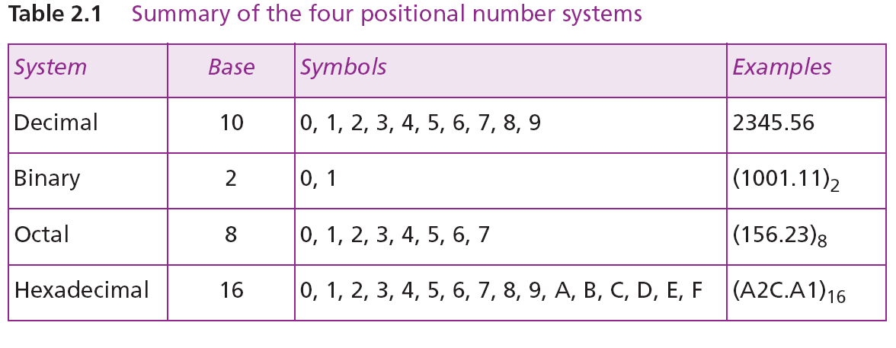
Summary of the four positional systems
Table 2.1 shows a summary of the four positional number systems discussed in this chapter.

Slide 20
How the number 0 to 15 is represented in different systems.

Slide 21
Conversion
We need to know how to convert a number in one system to the equivalent number in another system. Since the decimal system is more familiar than the other systems, we first show how to covert from any base to decimal. Then we show how to convert from decimal to any base. Finally, we show how we can easily convert from binary to hexadecimal or octal and vice versa.

Slide 22
Number Base Conversions
Evaluate Magnitude
Octal
(Base 8)
Evaluate Magnitude
Decimal
(Base 10)
Binary
(Base 2)
Hexadecimal
(Base 16)
Evaluate Magnitude

Slide 23
Decimal (Integer) to Binary Conversion
Divide the number by the ‘Base’ (=2)
Take the remainder (either 0 or 1) as a coefficient
Take the quotient and repeat the division
Example: (13)₁₀
Quotient
Remainder
Coefficient
13
/ 2 = 6
1 a₀ = 1
6
/ 2 = 3
0 a₁ = 0
3
/ 2 = 1
1 a₂ = 1
1
/ 2 = 0
1 a₃ = 1
Answer: (13)₁₀ = (a₃ a₂ a₁ a₀)₂ = (1101)₂
MSB LSB

Slide 24
Decimal (Fraction) to Binary Conversion
Multiply the number by the ‘Base’ (=2)
Take the integer (either 0 or 1) as a coefficient
Take the resultant fraction and repeat the division
Example: (0.625)₁₀
Integer
Fraction
Coefficient
0.625
* 2 = 1 . 25
a₋₁ = 1
0.25
* 2 = 0 . 5 a₋₂ = 0
0.5
* 2 = 1 . 0 a₋₃ = 1
Answer: (0.625)₁₀ = (0.a₋₁ a₋₂ a₋₃)₂ = (0.101)₂
MSB LSB

Slide 25
Decimal to Octal Conversion
Example: (175)₁₀
Quotient
Remainder
Coefficient
175
/ 8 = 21
7 a₀ = 7
21
/ 8 = 2
5 a₁ = 5
2
/ 8 = 0
2 a₂ = 2
Answer: (175)₁₀ = (a₂ a₁ a₀)₈ = (257)₈
Example: (0.3125)₁₀
Integer
Fraction
Coefficient
0.3125
* 8 = 2 . 5
a₋₁ = 2
0.5
* 8 = 4 . 0 a₋₂ = 4
Answer: (0.3125)₁₀ = (0.a₋₁ a₋₂ a₋₃)₈ = (0.24)₈

Slide 26
Binary − Octal Conversion
Octal | Binary
0 | 0 0 0
1 | 0 0 1
2 | 0 1 0
3 | 0 1 1
4 | 1 0 0
5 | 1 0 1
6 | 1 1 0
7 | 1 1 1
8 = 2³
Each group of 3 bits represents an octal digit
Example:
Assume Zeros
( 1 0 1 1 0 . 0 1 )₂
( 2 6 . 2 )₈
Works both ways (Binary to Octal & Octal to Binary)

Slide 27
Binary − Hexadecimal Conversion
Hex | Binary
0 | 0 0 0 0
1 | 0 0 0 1
2 | 0 0 1 0
3 | 0 0 1 1
4 | 0 1 0 0
5 | 0 1 0 1
6 | 0 1 1 0
7 | 0 1 1 1
8 | 1 0 0 0
9 | 1 0 0 1
A | 1 0 1 0
B | 1 0 1 1
C | 1 1 0 0
D | 1 1 0 1
E | 1 1 1 0
F | 1 1 1 1
16 = 2⁴
Each group of 4 bits represents a hexadecimal digit
Example:
Assume Zeros
( 1 0 1 1 0 . 0 1 )₂
( 1 6 . 4 )₁₆
Works both ways (Binary to Hex & Hex to Binary)

Slide 28
Octal − Hexadecimal Conversion
Convert to Binary as an intermediate step
Example:
( 2 6 . 2 )₈
Assume Zeros
Assume Zeros
( 0 1 0 1 1 0 . 0 1 0 )₂
( 1 6 . 4 )₁₆
Works both ways (Octal to Hex & Hex to Octal)

Slide 29
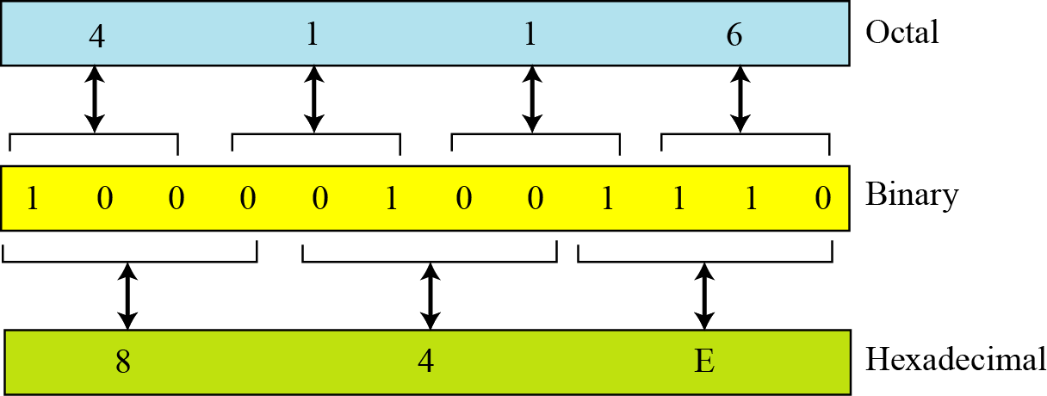
Octal-hexadecimal conversion
Figure 2.12 Octal to hexadecimal and hexadecimal to octal conversion

Slide 30
Example Binary to Decimal
The following shows how to convert the binary number (110.11)₂ to decimal: (110.11)₂ = 6.75.

Slide 31
Example: Hexadecimal to Decimal
The following shows how to convert the hexadecimal number (1A.23)₁₆ to decimal.
Note that the result in the decimal notation is not exact, because 3 × 16⁻² = 0.01171875. We have rounded this value to three digits (0.012).

Slide 32
Example Octal to Decimal
The following shows how to convert (23.17)₈ to decimal.
This means that (23.17)8 ≈ 19.234 in decimal. Again, we have rounded up 7 × 8⁻² = 0.109375.

Slide 33
Example: Decimal to Binary
The following shows how to convert 35 in decimal to binary. We start with the number in decimal, we move to the left while continuously finding the quotients and the remainder of division by 2. The result is 35 = (100011)₂.

Slide 34
Example: Decimal to Octal
The following shows how to convert 126 in decimal to its equivalent in the octal system. We move to the right while continuously finding the quotients and the remainder of division by 8. The result is 126 = (176)₈.

Slide 35
Example: Decimal to Hexadecimal
The following shows how we convert 126 in decimal to its equivalent in the hexadecimal system. We move to the right while continuously finding the quotients and the remainder of division by 16. The result is 126 = (7E)₁₆

Slide 36
Example: Decimal (Fraction) to Octal
The following shows how to convert 0.634 to octal using a maximum of four digits. The result is 0.634 = (0.5044)₈. Note that we multiple by 8 (base octal).

Slide 37
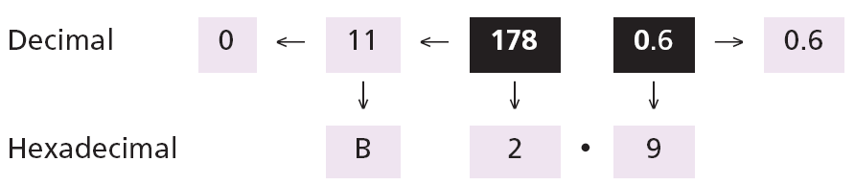
Example: Decimal (Fraction) to Hexadecimal
The following shows how to convert 178.6 in decimal to hexadecimal using only one digit to the right of the decimal point. The result is 178.6 = (B2.9)₁₆ Note that we divide or multiple by 16 (base hexadecimal).

Slide 38
Example: Decimal to binary (Alternative Method)
An alternative method for converting a small decimal integer (usually less than 256) to binary is to break the number as the sum of numbers that are equivalent to the binary place values shown:

Slide 39
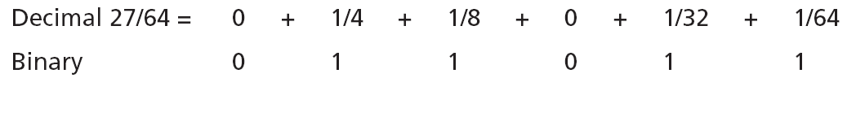
Example: Decimal fraction to binary (Alternative Method)
A similar method can be used to convert a decimal fraction to binary when the denominator is a power of two:
The answer is then (0.011011)₂

Slide 40
Example: Binary to Hexadecimal
Show the hexadecimal equivalent of the binary number (110011100010)₂.
Solution
We first arrange the binary number in 4-bit patterns:
100 1110 0010
Note that the leftmost pattern can have one to four bits. We then use the equivalent of each pattern o change the number to hexadecimal: (4E2)₁₆.

Slide 41
Example: Hexadecimal to Binary
What is the binary equivalent of (24C)₁₆?
Solution
Each hexadecimal digit is converted to 4-bit patterns:
2 → 0010, 4 → 0100, and C → 1100
The result is (001001001100)₂.

Slide 42
Example: Binary to Octal
Show the octal equivalent of the binary number (101110010)₂.
Solution
Each group of three bits is translated into one octal digit. The equivalent of each 3-bit group is shown in Table 2.2 on page 25.
101 110 010
The result is (562)₈.

Slide 43
Example: Octal to Binary
What is the binary equivalent of for (24)₈?
Solution
Write each octal digit as its equivalent bit pattern to get
2 → 010 and 4 → 100
The result is (010100)₂.

Slide 44
NONPOSITIONAL NUMBER SYSTEMS
Although non-positional number systems are not used in computers, we give a short review here for comparison with positional number systems. A non-positional number system still uses a limited number of symbols in which each symbol has a value. However, the position a symbol occupies in the number normally bears no relation to its value—the value of each symbol is fixed. To find the value of a number, we add the value of all symbols present in the representation.

Slide 45
Example: Non-positional Number system
Roman numerals are a good example of a non-positional number system. This number system has a set of symbols S = {I, V, X, L, C, D, M}. The values of each symbol are shown in bellow.
To find the value of a number, we need to add the value of symbols subject to specific rules (See the textbook).

Slide 46
Example
(Continued)
The following shows some Roman numbers and their values.

Slide 47
Thank you..

